Slide 1


PROPOSAL
Azure Devops | For CSC Global

Slide 2


Azure DevOps
Duration: 24 Hours (3 days)

Slide 3
PROGRAM CURRICULUM
Day | Module | Content
Day 1 | Module 1: Azure DevOps Overview | - What is Azure DevOps? - Azure DevOps vs GitHub Actions vs Jenkins - Key Services: Repos, Pipelines, Boards, Artifacts, Test Plans - DevOps lifecycle & best practices - Organization → Project → Repos → Pipelines hierarchy
 | Module 2: Source Code Management (Repos) | - Creating organizations & projects - Importing repositories (Git / TFVC) - Branching strategies (main/develop/feature) - Pull requests & code reviews - Policies, merge strategies & branch protection - Lab: Create Repo, push code, manage branches
 | Module 3: Boards & Work Item Tracking | - Agile vs Scrum vs Kanban in Azure Boards - Epics → Features → User Stories → Tasks - Creating custom fields & dashboards - Sprint planning & burndown charts - Lab: Create Boards for sample project
Day 2 | Module 4: Pipelines Basics | - Classic vs YAML pipelines - Build agents (hosted vs self-hosted) - Triggers (branch, path, PR) - Variables & secrets management - Lab: Create YAML build pipeline for .NET / Java app
 | Module 5: Build & Test Automation | - Tasks and templates - NuGet / NPM / Maven package restore - Unit testing and test results publishing - Code coverage & lint checks - Lab: Run automated build + tests + artifact publish

Slide 4
PROGRAM CURRICULUM
Day | Module | Content
Day 2 | Module 6: Artifacts & Package Feeds | - Azure Artifacts overview - Managing NuGet / NPM feeds - Versioning and artifact retention policies - Lab: Publish package to feed and consume in pipeline
Day 3 | Module 7: Continuous Deployment (CD) | - Multi-stage pipelines (YAML) - Environments & approvals - Deployment strategies (canary, blue-green, rolling) - Lab: Deploy app to Azure App Service / VM
 | Module 8: Infrastructure as Code in Azure DevOps | - Integrating Terraform / ARM / Bicep - Service connections (Azure RM / Service Principal) - Lab: Provision Azure resources via Terraform pipeline
 | Module 9: Security & Monitoring | - Secrets & service connections best practices - Integrating SonarCloud / Snyk for code analysis - Build & release auditing / approvals - Monitoring pipeline runs & troubleshooting
 | Module 10: Final Capstone Lab + Wrap-Up | - Build + Test + Deploy end-to-end pipeline - Add boards, repo, and artifact integration - Reporting & dashboard creation - Q&A / Best Practices / Certification Path

Slide 5
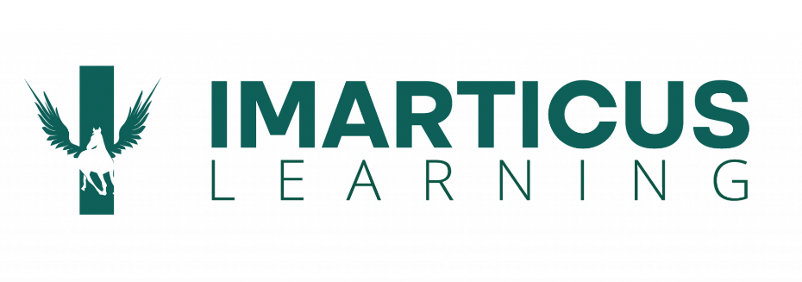

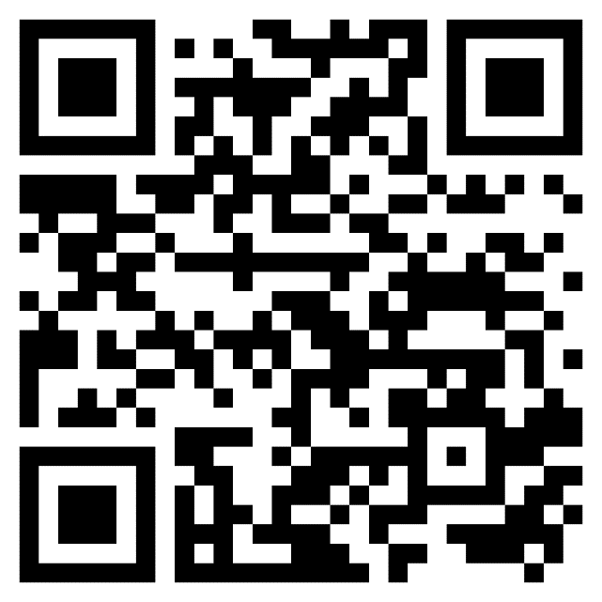
Thank You!
Scan Now For
Training solutions page
We build the workforce of the future.

